Slide 1
MBA 6693: Business Analytics | Credit Case Study
UNB Fredericton
Gabriel Olawale Adeyemo | Jiyi (Tony) Xia
Notes:
A very good afternoon everyone! The topic for today’s presentation is international HR Management, also known as Expatriate Management. The presenters are Dharmendra, Tony, and myself.
Today, we bring to you the story of us. We have travelled in a similar boat of having to move to Canada, but only difference is that we are here as students and not as employees. Most of the experiences that an expat would have on their international assignment are similar to what we have faced. So, today we will look at Expatriate management and understand more about it.

Slide 2

CREDIT CASE STUDY
Problem Statement
Objective
Given historic customer and loan application data and loan default, the bank requires some ways to make decisions on future loans to reduce the rate of defaulting loans.
To analyze historic data, identify important factors in loan applications and to provide an accurate model to predict the outcome of future loans to reduce the cost of failed loan for the bank.

Slide 3
APPROACH TO SOLUTION
Data understanding
Data processing
Exploratory data analysis
Model building
Comparison of models

Slide 4
DATA PREPROCESSING
Check for duplicated records
Merge two data files
Check for NA values
Check for outliers
Use information gain to choose 10 top-ranking variables

Slide 5
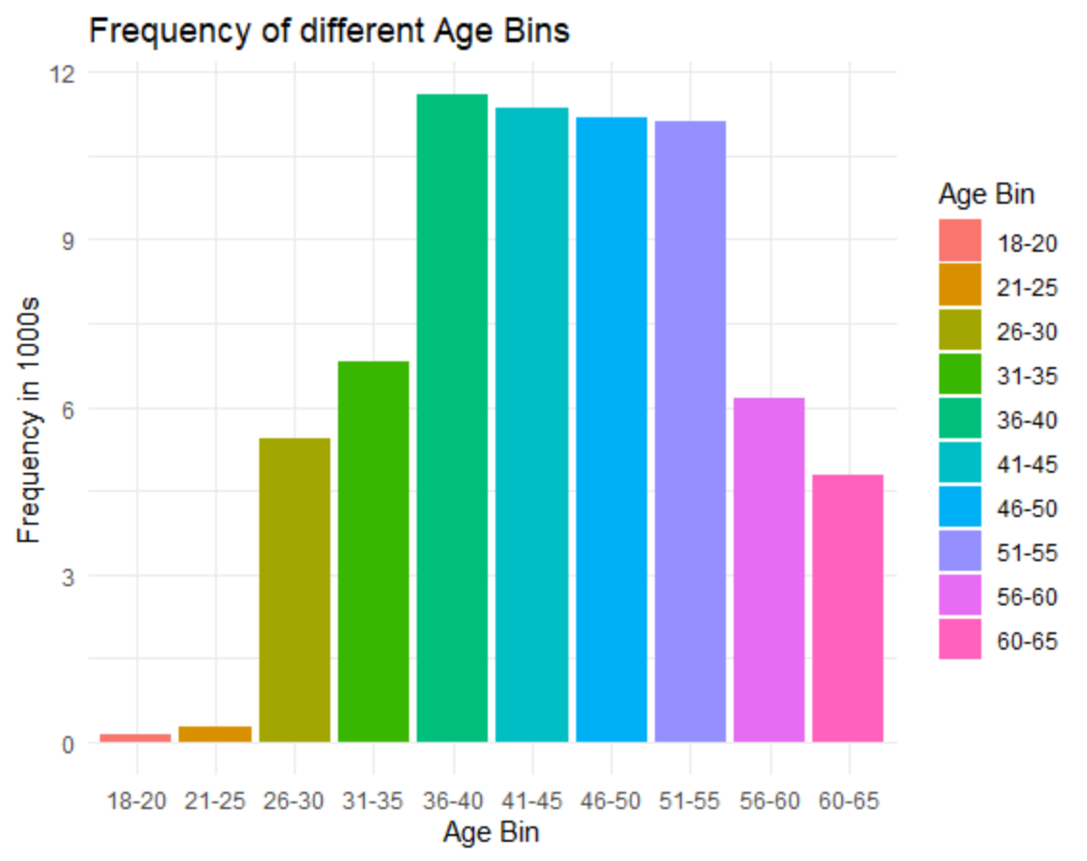
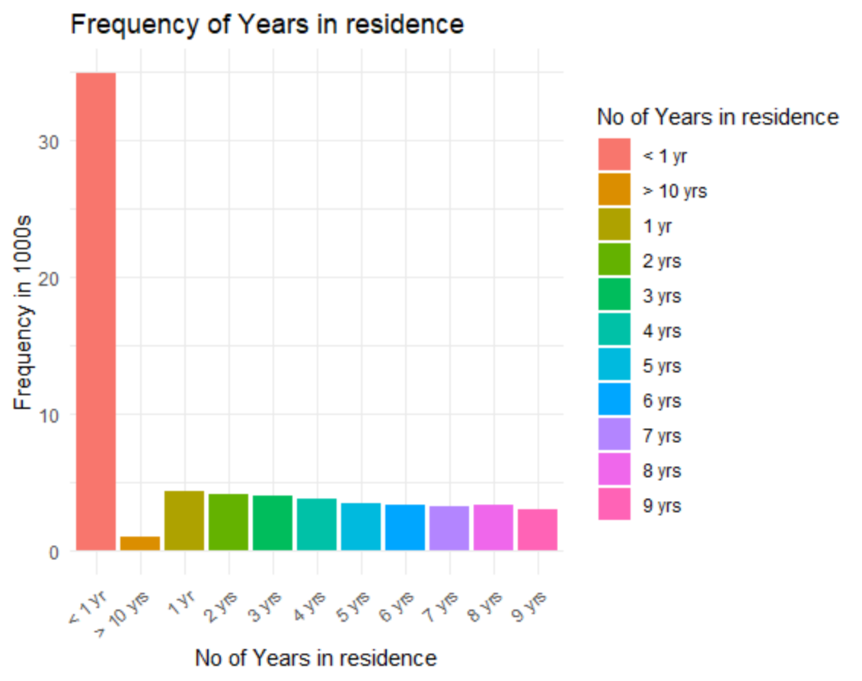
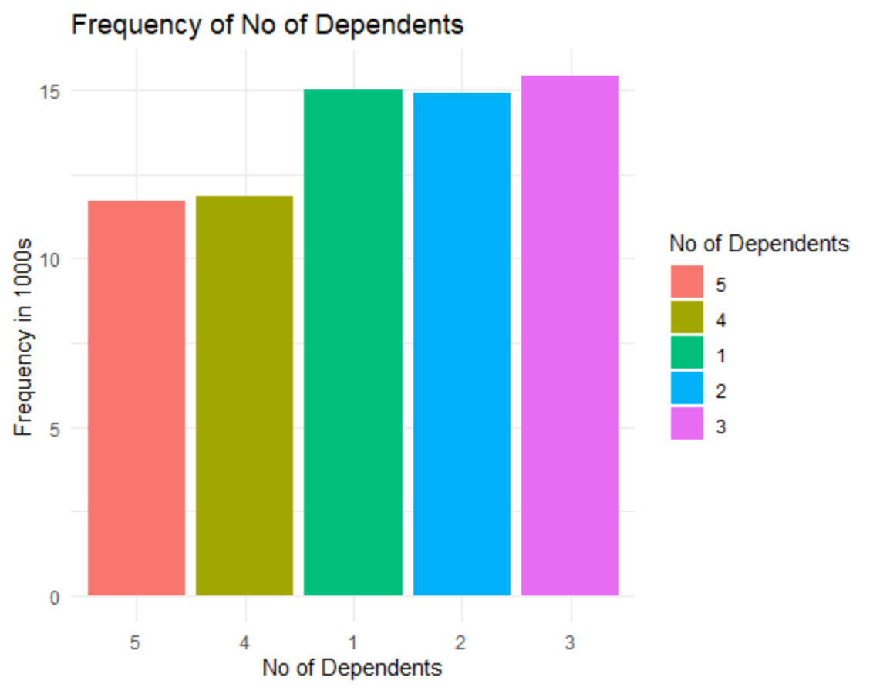
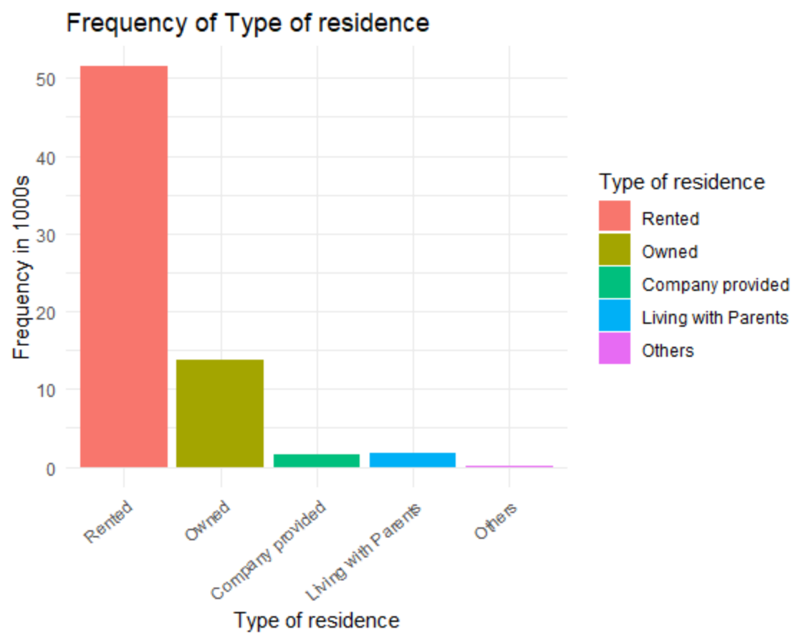
EDA-UNIVARIATE ANALYSIS

Slide 6
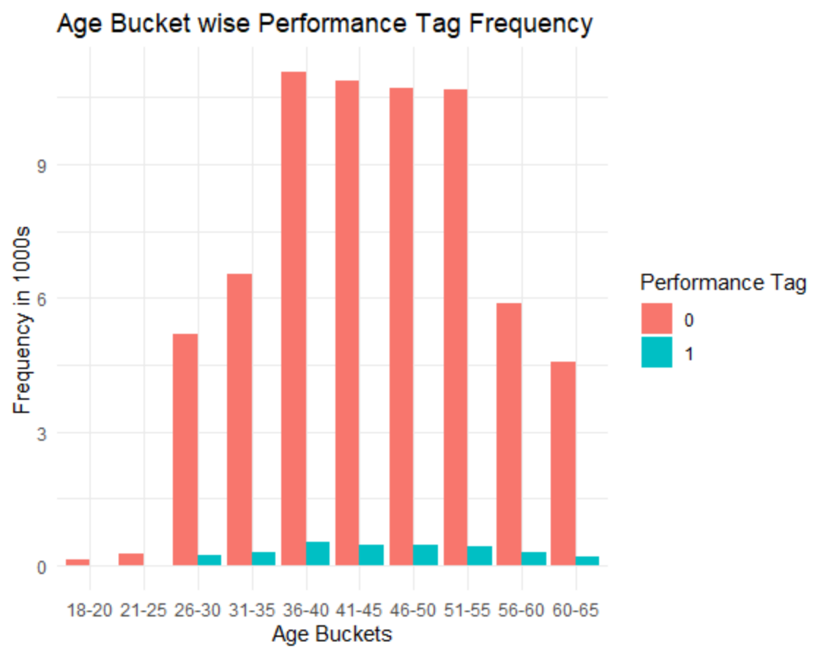
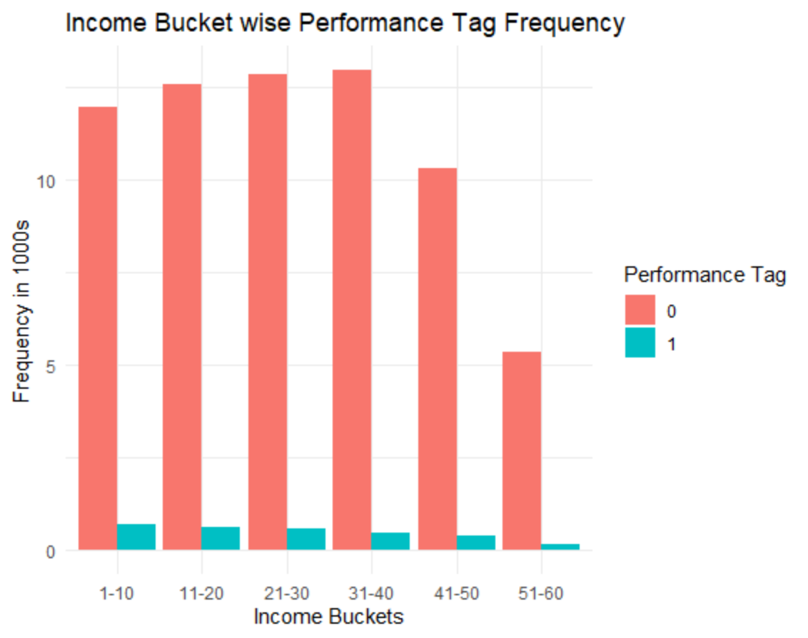
EDA-BIVARIATE ANALYSIS

Slide 7
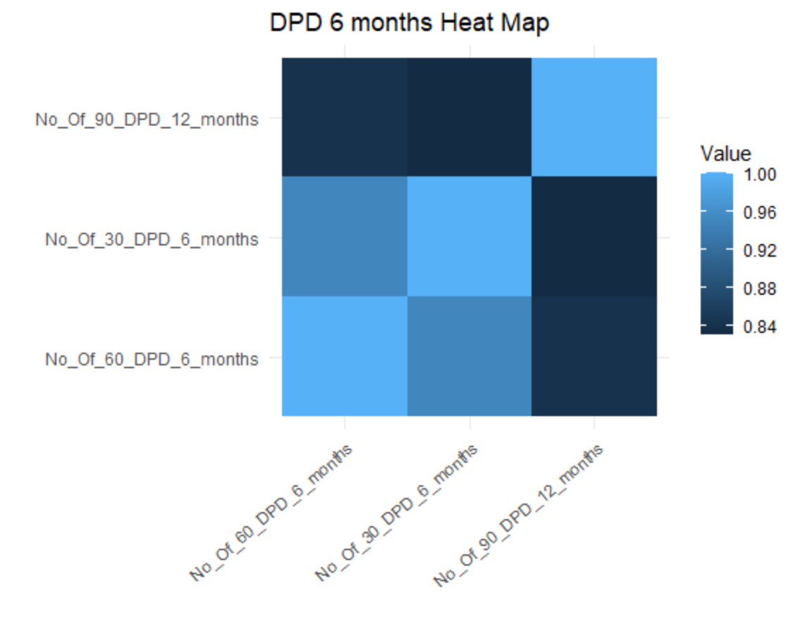
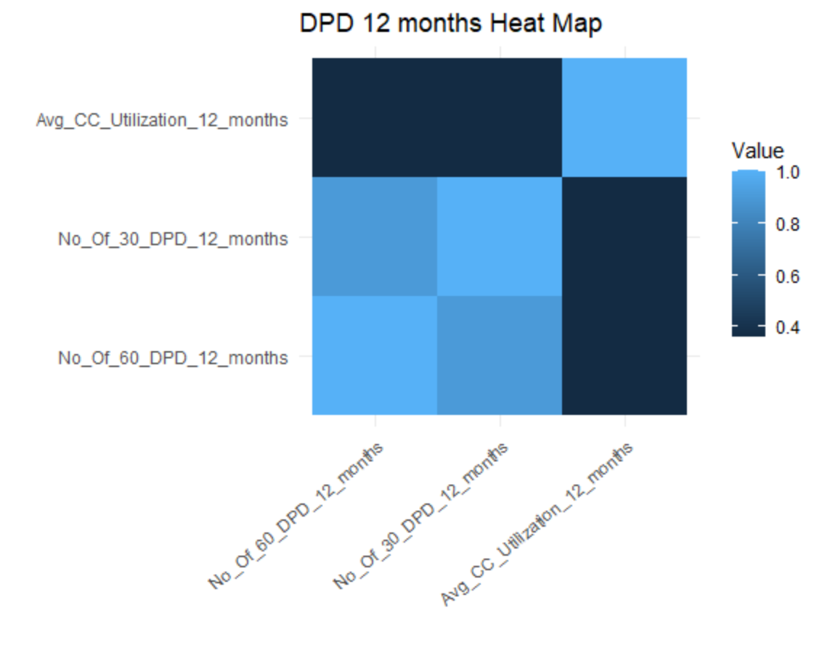
CORRELATION ANALYSIS

Slide 8
MODEL BUILDING
OUTLIER TREATMENT
DATA SPLIT
DATA SAMPLING
We replaced outliers in one variable with the mean of that variable
train/test split
5-fold cross-validation
We sampled data using ROSE package for balancing the training data sets.

Slide 9
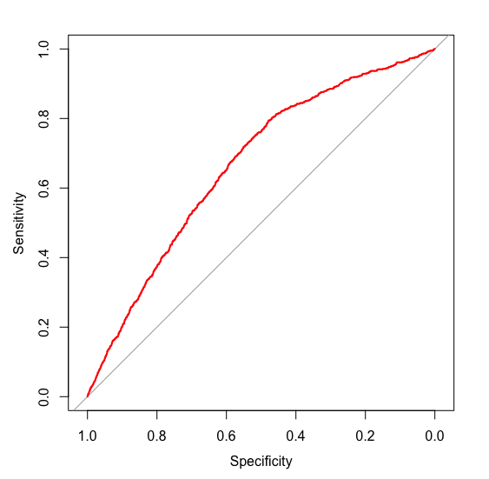
LOGISTIC REGRESSION
The Logistic Regression Model with the top variables from the data for Predicting loan default with an accuracy of 62%
Important Predictors:
Confusion Matrix
Area under the ROC Curve: 0.6657
Model Statistics
"Avg_CC_Utilization_12_months", "Trades_12_months", "Inquiries_12_months", "Outstanding_Balance", "No_Of_30_DPD_6_months", "PL_Trades_12_months", "Months_In_Current_Residence", "Total_No_of_trades", "No_Of_30_DPD_12_months", "No_Of_90_DPD_12_months"
Statistics | Values
Cut-off | 0.5060606
Accuracy | 62.61%
Sensitivity | 62.11%
Specificity | 62.63%
 | Reference | Reference
 |  | No | Yes
Prediction | No | 12588 | 324
 | Yes | 7511 | 531

Slide 10
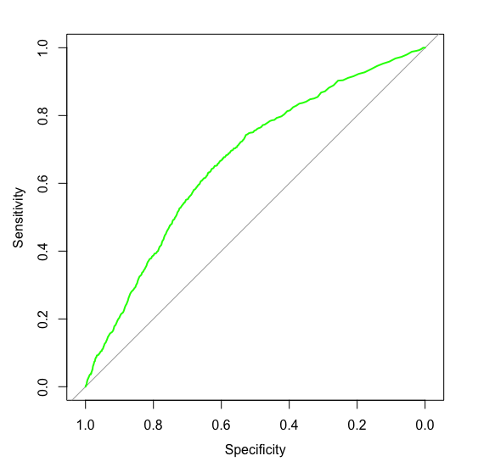
RANDOM FOREST
The Random Forest given all variables from the data for Predicting loan default with an accuracy of 85% which is better than Logistic model
Important Predictors: All variables
Confusion Matrix
Area under the ROC Curve: 0.6664
Model Statistics
Statistics | Values
Accuracy | 85.11%
Sensitivity | 87.67%
Specificity | 25.03%
 | Reference | Reference
 |  | No | Yes
Prediction | No | 17620 | 641
 | Yes | 2479 | 214

Slide 11
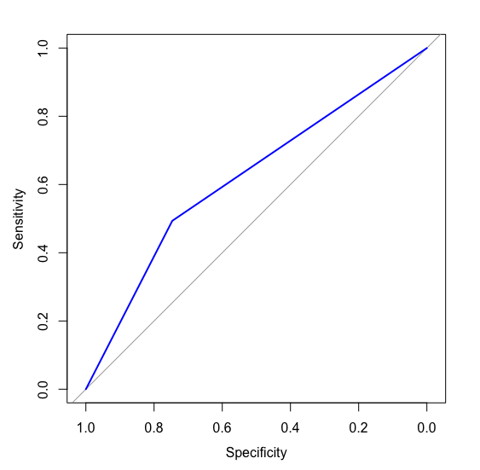
SUPPORT VECTOR MACHINE
The Support Vector Machine given all variables from the data for Predicting loan default with an accuracy of 73% which is also better than Logistic model
Important Predictors:: All variables
Confusion Matrix
Area under the ROC Curve: 0.6201
Model Statistics
Statistics | Values
Accuracy | 73.62%
Sensitivity | 97.20%
Specificity | 7.65%
 | Reference | Reference
 |  | No | Yes
Prediction | No | 15005 | 5094
 | Yes | 433 | 422

Slide 12
COMPARISON OF MODELS
ROC Curve for final model:
Logistic Regression
Random Forest
SVM

Slide 13
COMPARISON OF MODELS
A comparison of the three models show that Logistic Regression performs better averagely based on accuracy specificity and sensitivity
 | Logistic Regression | Random Forest | Support Vector Machine
Accuracy | 62.61% | 85.11% | 73.62%
Sensitivity | 62.11% | 87.67% | 97.20%
Specificity | 62.63% | 25.03% | 7.65%
AUC | 0.6657 | 0.6664 | 0.6201
We choose the logistic regression model as our best model

Slide 14
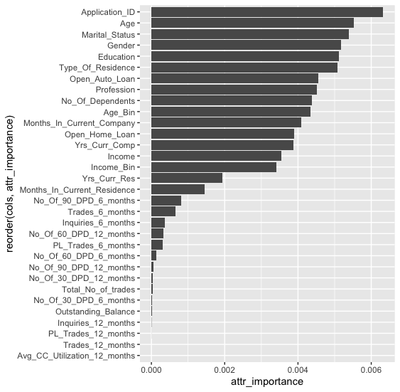
APPENDIX
A chart showing the Predictive importance of variables in the dataset derived using information gain

